Slide 1

Instructions
Welcome to our third online training session!
Please read through this deck in advance of next week’s session.
On some slides you will see an icon - please click to hear more.
Next week’s session will be an interactive video call which will test your understanding of the material!

Slide 2
Recap: Scrum

Slide 3
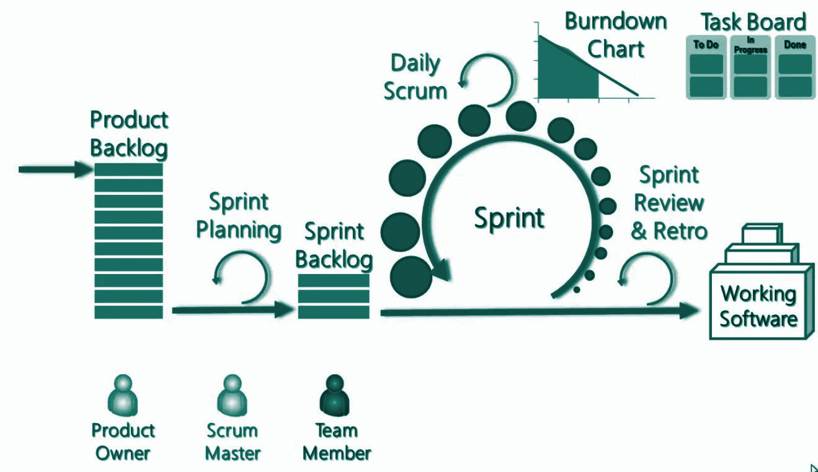
What is Scrum?
SCRUM is one of many agile methodologies used by software companies since 1993.
It is particularly characterised by its sprints, ceremonies and roles (read on!).
A Sprint is a a time-box of one month or less during which a “Done”, useable, and potentially releasable product increment is created.
Sprints have consistent durations.
Work is taken into a sprint from the product backlog, defined by a Product Owner. Once the sprint starts scope cannot be added to the sprint..
A new Sprint starts immediately after the conclusion of the previous Sprint.
At the end of of each sprint the team should be able to ship working software.

Slide 4
Ceremonies
Week 1 | Monday | Tuesday | Wednesday | Thursday | Friday
 | Daily standup | Daily standup | Daily standup | Daily standup | Daily standup
 |  |  | Backlog Refinement | Demo | Sprint Retrospective
Week 2 | Monday | Tuesday | Wednesday | Thursday | Friday
 | Sprint Planning | Daily standup | Daily standup | Daily standup | Daily standup
Week 3 | Monday | Tuesday | Wednesday | Thursday | Friday
 | Daily standup | Daily standup | Daily standup | Daily standup | Daily standup
 |  | Prioritization | Backlog Refinement | Demo | Sprint Retrospective
Week 4 | Monday | Tuesday | Wednesday | Thursday | Friday
 | Sprint Planning | Daily standup | Daily standup | Daily standup | Daily standup
Week 5 | Monday | Tuesday | Wednesday | Thursday | Friday
 | Daily standup | Daily standup | Daily standup | Daily standup | Daily standup
 |  | Prioritization | Backlog Refinement | Demo | Sprint Retrospective
Daily Standup (15 minutes each day)
Attendees: Scrum team
Backlog Refinement (1 hour, 1 week before new sprint begins)
Attendees: Scrum team
Demo(½ - 1 hour, the day before the end of the sprint) Attendees: Scrum team, Business Stakeholders
Sprint Planning(½ - 1 hour, day 1 of new sprint) Attendees: Scrum team
Sprint Retrospective(½ hour, last day of the sprint)
Attendees: Scrum team

Slide 5





Scrum Roles
Scrum is characterised by specific roles which have distinct responsibilities:
Product Owner
Scrum Master
Team Member
Takes the inputs of what the product should be and translates them into a product vision and backlog.
Does whatever it takes to make the Scrum Team successful, such as removing organizational impediments, facilitating meetings, acting as a gatekeeper so no one unnecessary interrupts the team's work.
Develops the product envisioned by the Product Owner. The team should be cross functional i.e. include all the skills required to build a potentially shippable product.

Slide 6
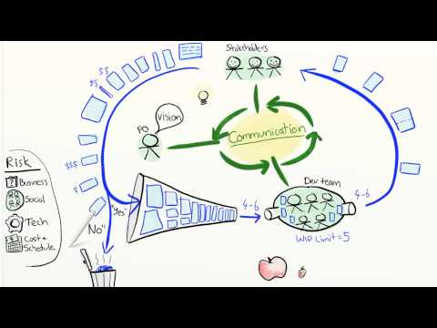
Product Owner
Notes:
Run to 5 mins 40 seconds.
RuVideo - https://www.youtube.com/watch?v=502ILHjX9EE

Slide 7
Planned Velocity
The initial capacity of ‘Agile Bucket’ = planned velocity - how much the team think they can deliver. However actual velocity is used for future sprints - this ensures the sprint plan is accurate as it is based on previous velocity not optimistic estimation
Planned
Velocity
Actual
Velocity
Next Planned
Velocity
1
1
2
1
1
2
2
2
2
2
= 16
= 12
= 12
1
1
2
1
1
2
4
4
4
4

Slide 8
Product Manager role

Slide 9
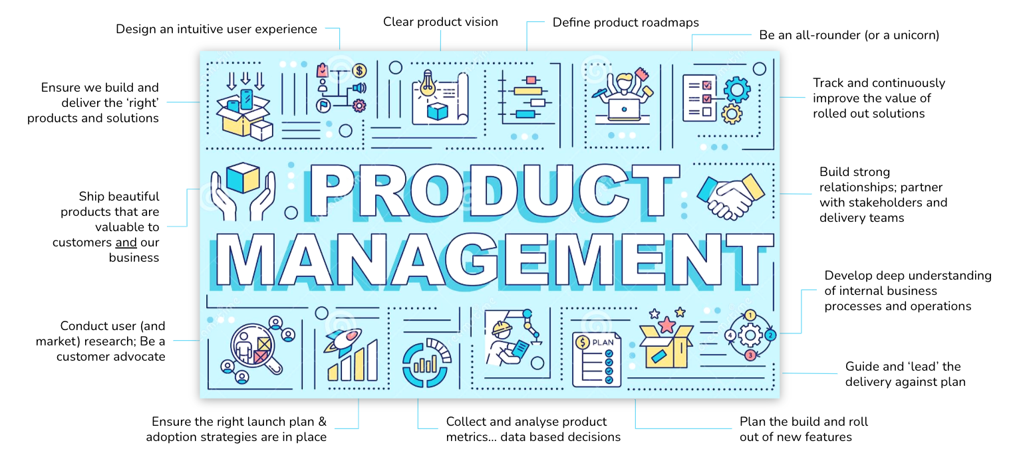
What is Product?

Slide 10
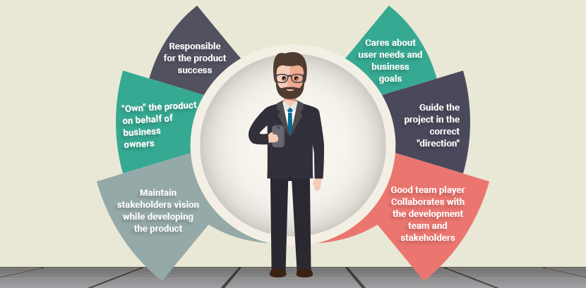
Product Owner

Slide 11
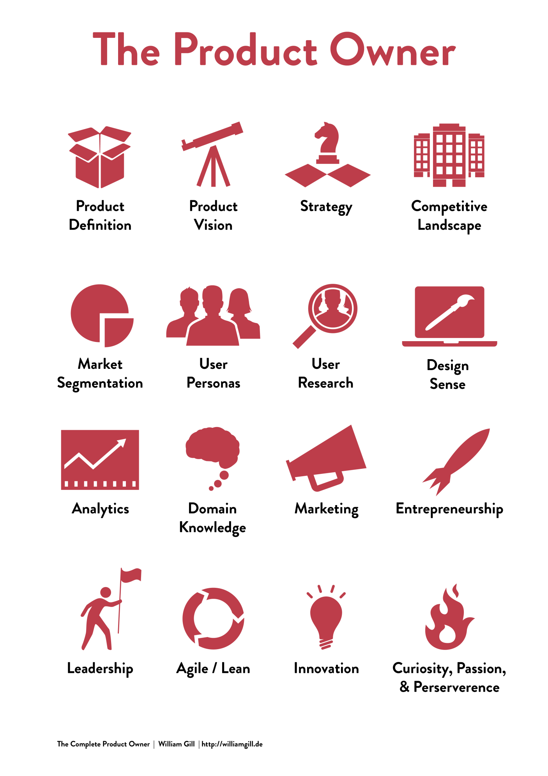
Product Manager Characteristics

Slide 12
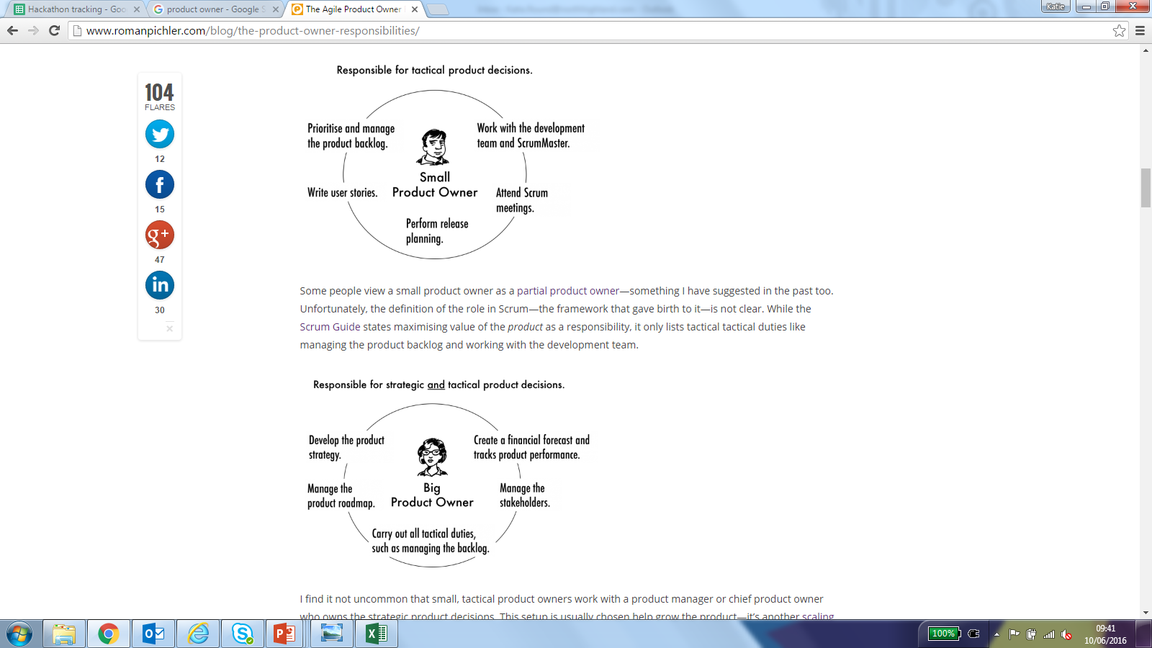
Product Manager Types

Slide 13
Product Vision

Slide 14
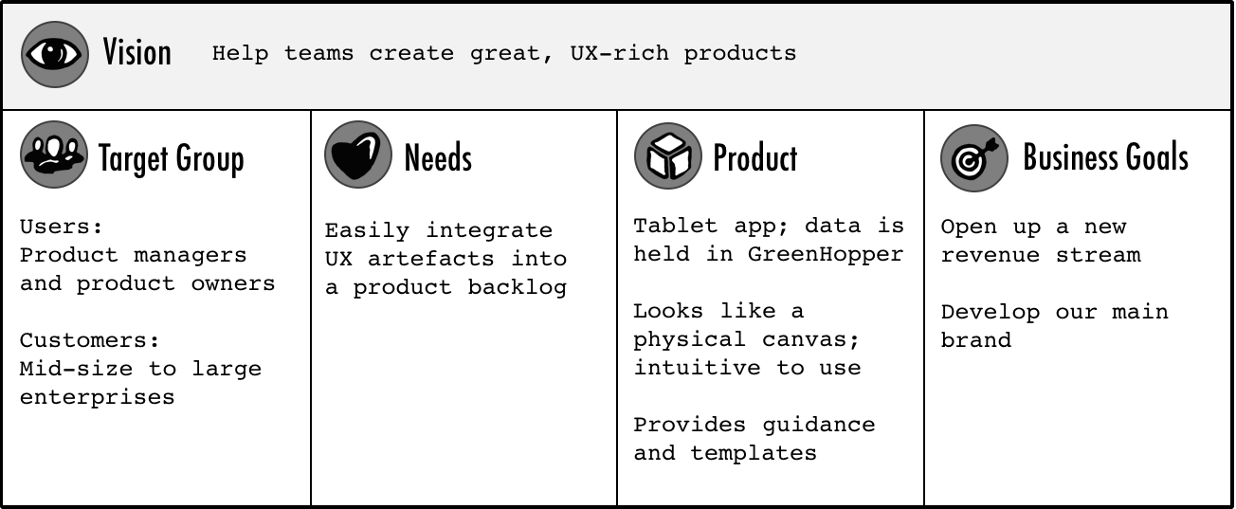
Product Vision
“The product vision is the overarching goal you are aiming for, the reason for creating the product. It provides a continued purpose in an ever-changing world, acts as the product's true north, provides motivation when the going gets tough, and facilitates effective collaboration” Roman Pilcher
Notes:
Alice

Slide 15
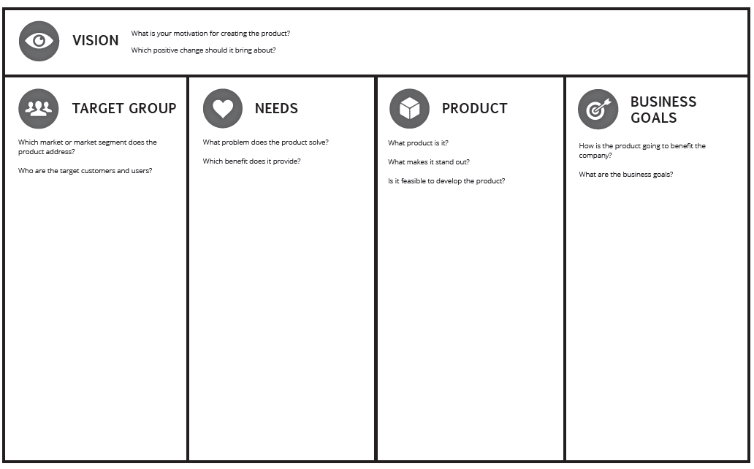
Prework
Using a current product / feature / project complete a worked example of the a product vision.
Timebox yourself to 15 mins.
You will be presenting this at the next session.
Notes:
66on n jhhhhhhhhhhhhhhhhhhhhhhhhhhhhhhhhhhhhhhhhhhhhhhhhhhhhhhhhhhhhhhhhhhhhhhhhhhhhhhh-y0011011110100

Slide 16
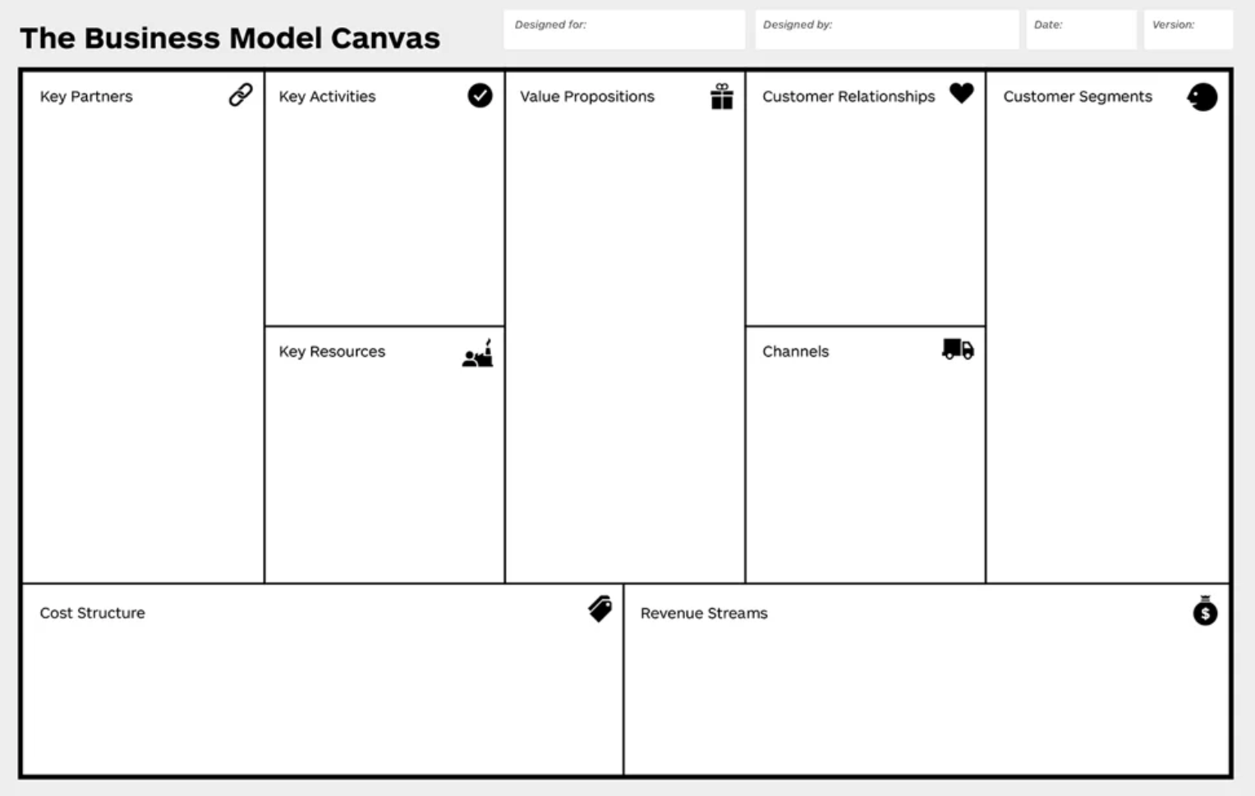
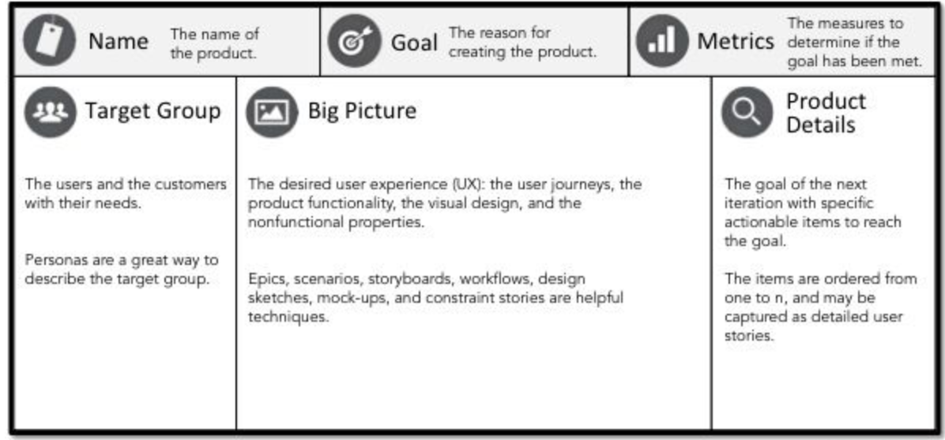
Product Canvas
Once you have defined and agreed a product vision with stakeholders you can flesh out a product canvas or business canvas. Choose your tool based on the needs of your feature or project.

Slide 17
The Backlog

Slide 18
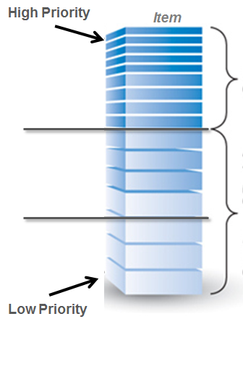
Product Backlog
The agile product backlog an ordered and emerging list of user needs plus anything else that is required to fulfil the product vision. It’s is ever-evolving and never baselined, ‘signed-off’ or static.
High Priority: Items prioritized and a good level of detail provided
Mid Priority: Might prioritise features at this depth based on release schedule
Low Priority: Little effort goes into prioritizing items for future releases

Slide 19
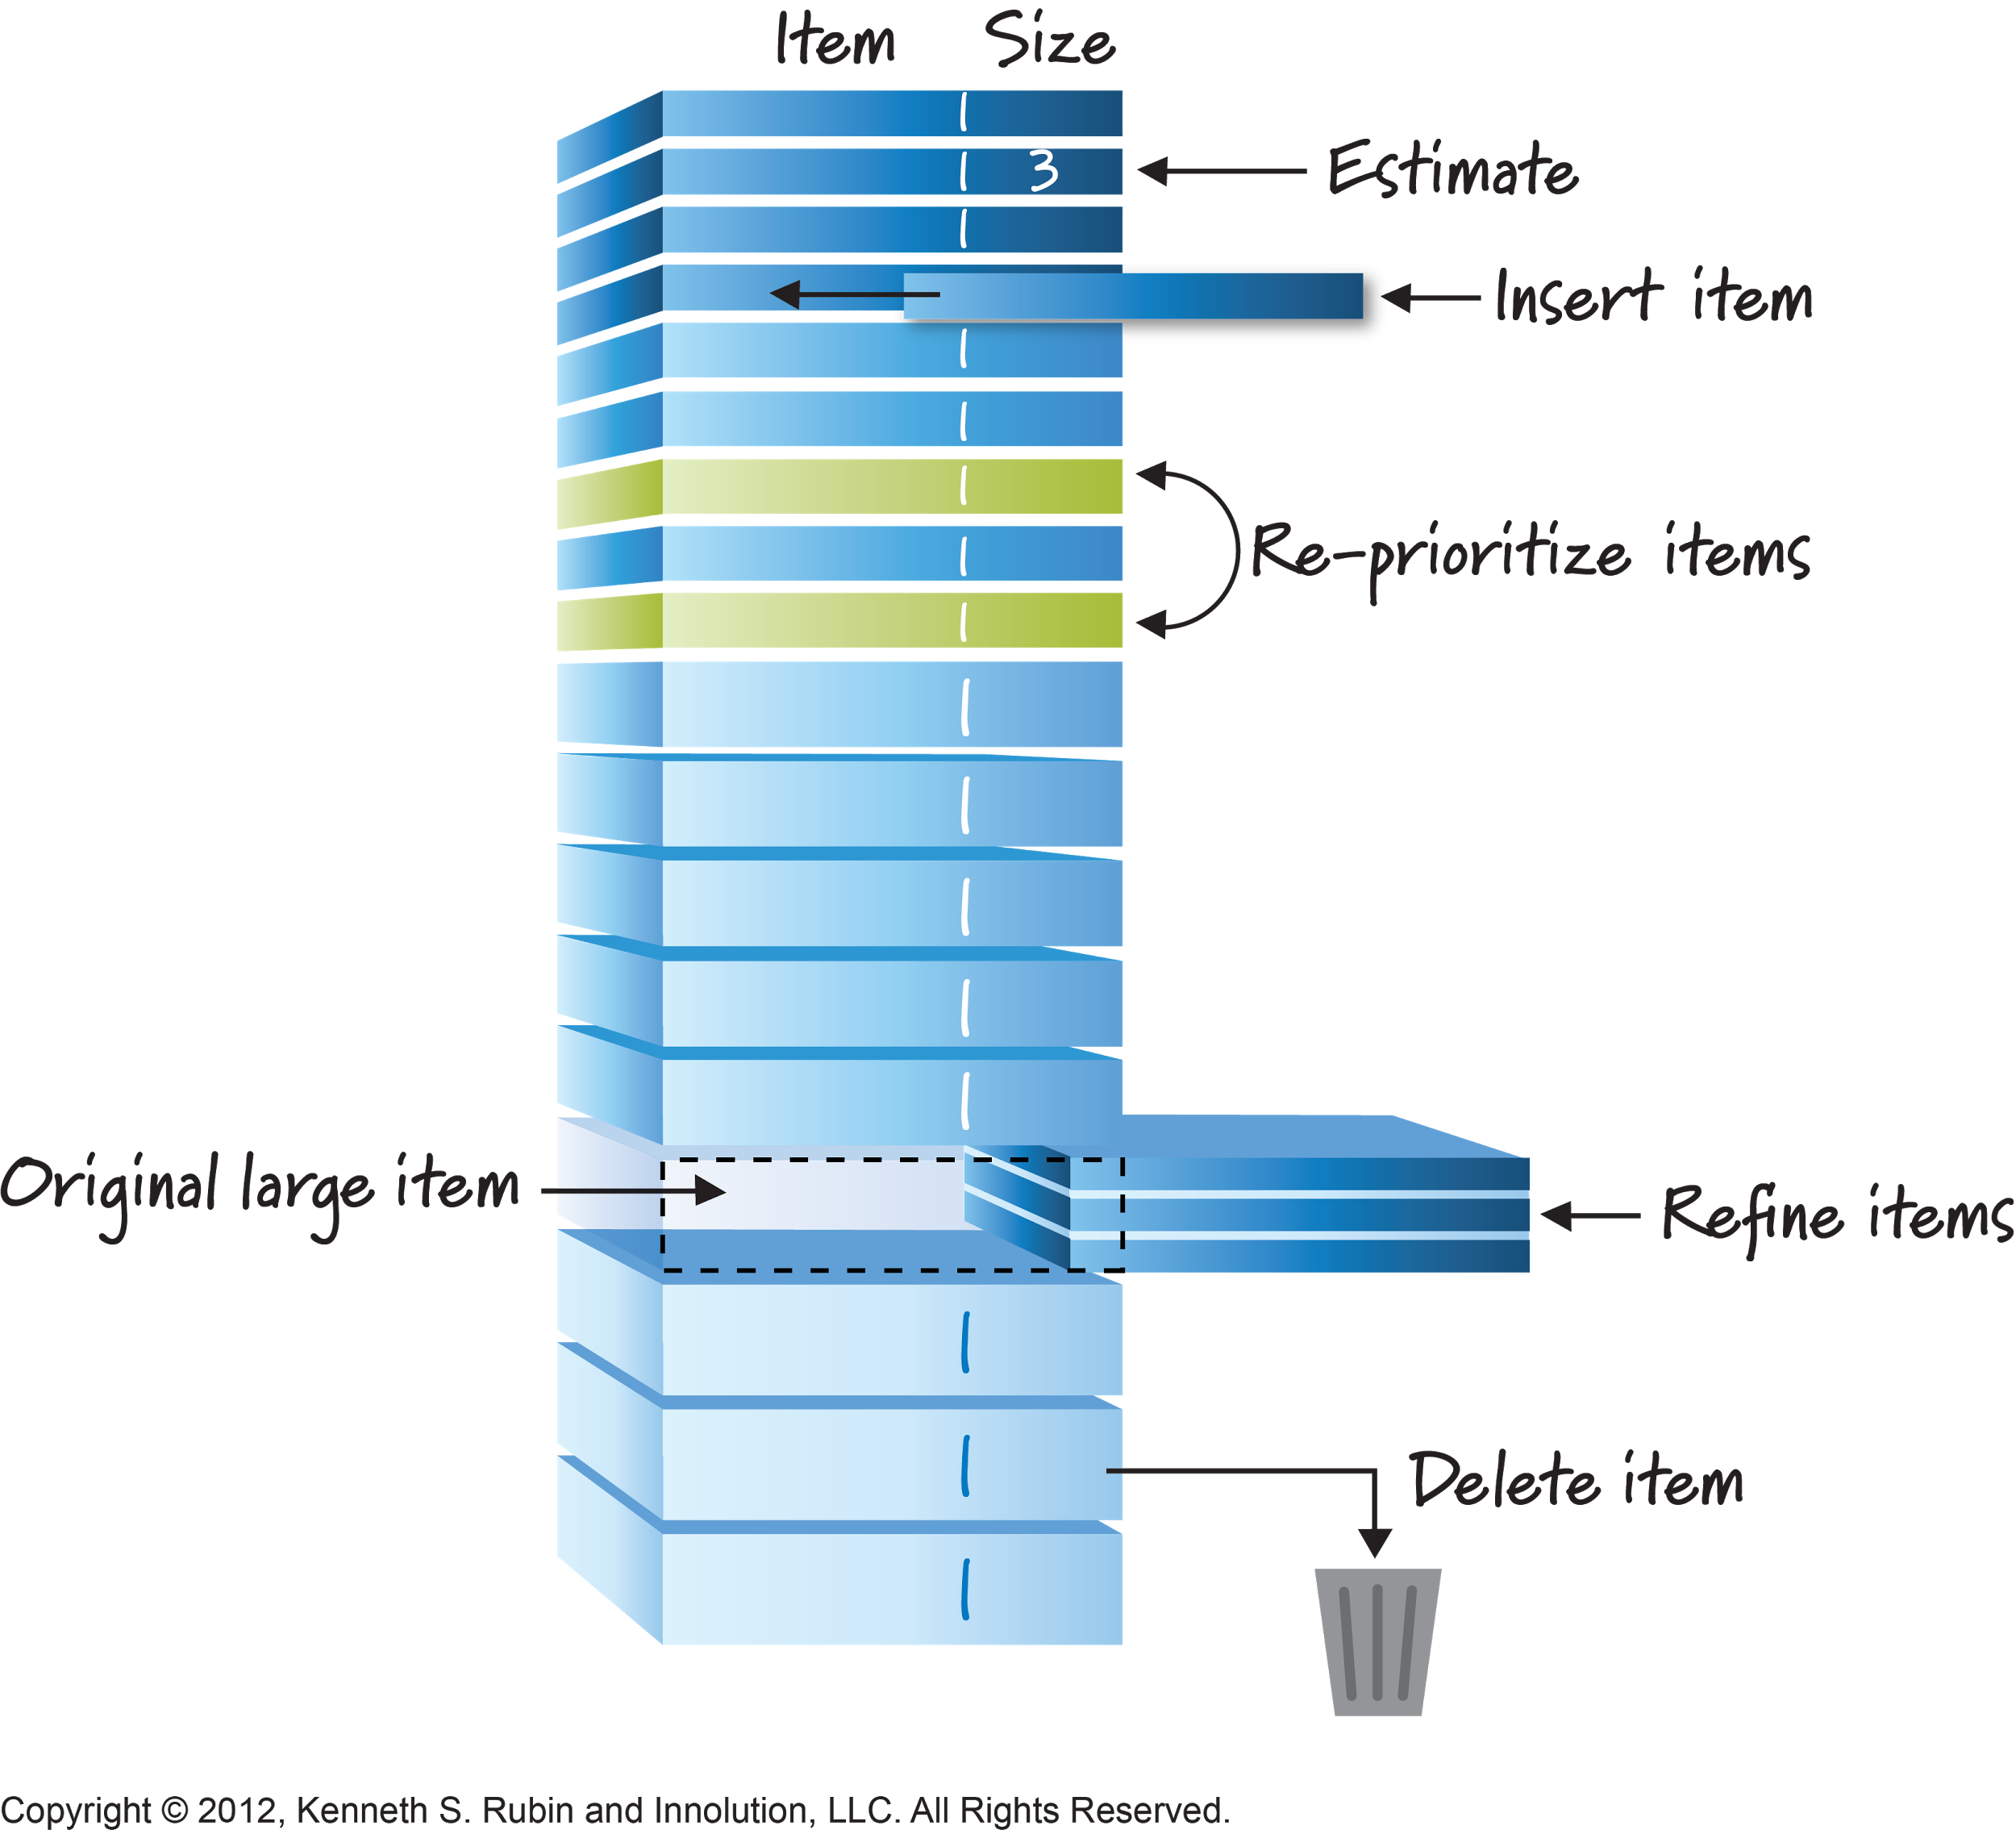
Product Backlog
The product backlog should be continuously refined as you learn more about the needs of the business.
Larger items should be broken down into smaller items that are easier to estimate and deliver.
Items that are no longer required or superseded can be deleted.
New items can be slotted in higher up the backlog (but outside an active sprint).
Your sprint backlog will be made up of ready well defined items at the top of the list.

Slide 20
Epics, Stories, Tasks, ACs

Slide 21
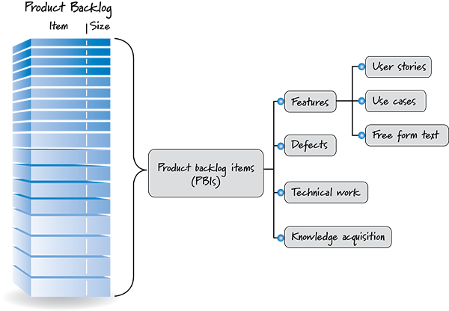
Breaking down the product backlog
The agile product backlog can be made up of a number of different items including features, bugs, technical debt and research.
The key thing is to keep breaking items down into smaller constituents that are easier to build and test.

Slide 22
Epics, stories, tasks, acceptance criteria
EPIC
A large user story that can’t be completed within one sprint. A number of smaller user stories sit beneath the epics.
USER STORY
A short, simple description of a feature from the users perspective.
The “AS A/I WANT/SO THAT” format makes it clear exactly who requires the feature, what the feature is and the benefit and value of it
TASK
Written by the team who are developing the stories, tasks describe the HOW.
ACCEPTANCE CRITERIA
Written against every story, conditions that must be met in order to satisfy the user story

Slide 23

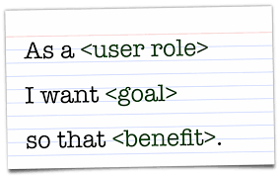
User Stories
A good user story is…
Independent (of all other)
Negotiable (not a fixed solution)
Valuable (a vertical slice)
Estimatable (to an approximation)
Small (enough to fit into a sprint)
Testable (once completed)

Slide 24
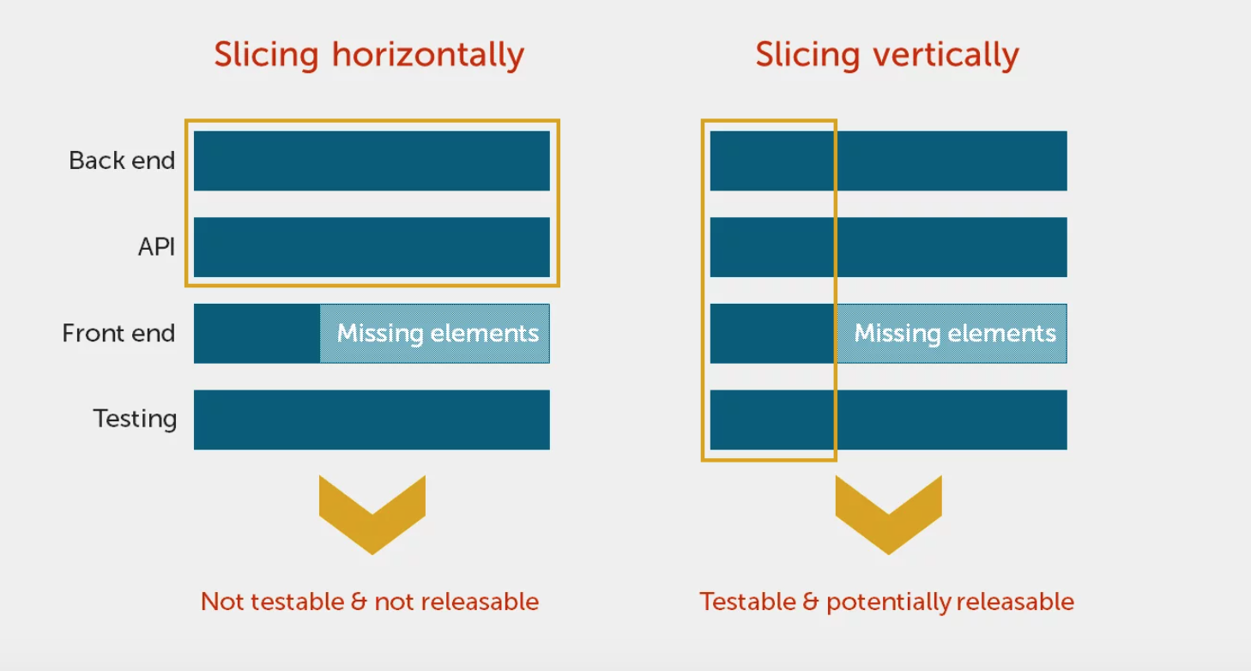
User stories

Slide 25
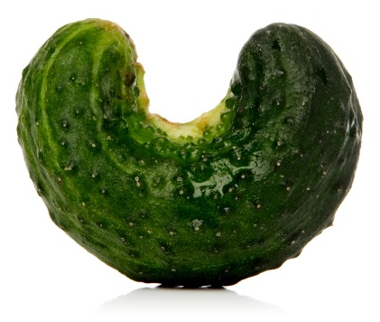
Acceptance criteria
As a Customer Care agent I want to disable promotional SMS for a customer so that they do not receive unwanted SMS.
GIVEN I am a Customer Care agent on the customer details page
WHEN I select disable from the drop down
THEN the selection is saved in the customer’s profile
AND the customer no longer receives promotion eligibility SMS.

Slide 26
Definition of Done
The team will agree a standard definition of done which applies to every story in the backlog
If a story has not achieved the definition of done, it must be returned to the product backlog and not be completed as part of this sprint
The definition of done provides a common understanding to the entire team of what is needed in order for the stories to be completed
DoD
All acceptance criteria have been met
Code has been peer reviewed
UI guidelines followed
All tests have passed
Reviewed and signed off by product owner

Slide 27
The end!
Look forward to seeing you on Thursday for the training session.

